Slide 1
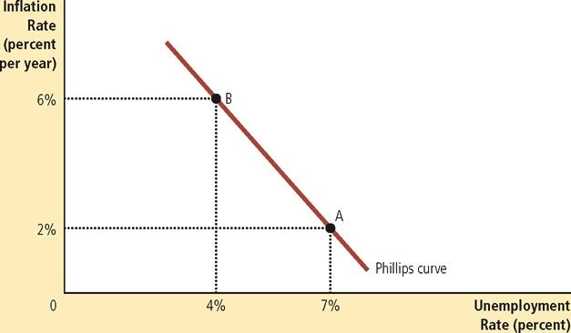
Short Run Trade-Off Between Inflation and Unemployment
Low inflation and low unemployment rates are an impossible combination.
Phillips Curve allows policymakers to see possible economic outcomes.
Inflation and unemployment are both important indicators of economic performance
Natural rate of unemployment is affected by:
  Minimum and efficiency wages
  Union power in the market
  Job search efficiency
Inflation
  Nation’s central bank controls the growth in the money supply
Notes:
In Economics, policymakers are faced with a short run trade-off between inflation and unemployment. This trade-off occurs because the nation can’t have both a low unemployment rate and low inflation rates. These two indicators of economic performance can’t be low at the same because as the Phillips Curve shows, when the policymakers are able to expand the output and lower unemployment, it is only temporary because is causes a more rapid increase in the price level. According to Mankiw, “If policymakers contract aggregate demand and move the economy down the short-run aggregate-supply curve, they can lower inflation, but only at the cost of temporarily lower output and higher unemployment” (2015). Inflation is affected by the growth in money supply that the Nation’s Central Bank controls. While the natural rate of unemployment is affected by minimum wage, efficiency in wages and job searches, and the power that unions have in the current market. This shows that these two important economic indicators may, at some point in time, be low at the same time, but in order to keep the economy balanced, the policymakers are faced with the trade-off of between inflation and unemployment.
Completed by Nicole Griego, Learning Team C
Reference:
Mankiw, N.G. (2015). Principles of Macroeconomics, 7th Edition. Stamford, CT: Cengage Learning.

Slide 2
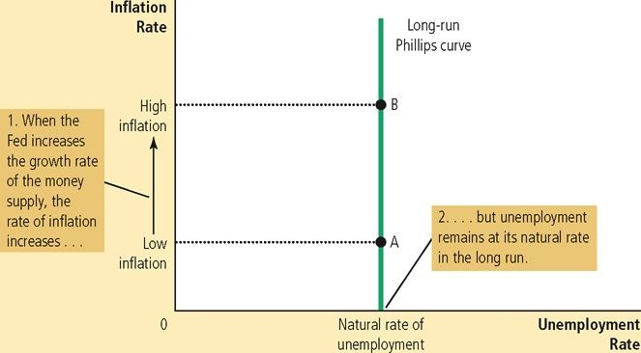
Unemployment Trade-Off in the Long Run
Vertical long-run Phillips Curve represents monetary neutrality.
Monetary policies
  Influence price level and inflation rate
  Do not influence output and unemployment rates
Unemployment rates go towards its natural rate when the federal money supply is increased slowly and quickly.
Unemployment trade-offs disappear in the long run because there is no relation to monetary growth and inflation.
Notes:
Unemployment trade-off in the long run disappear because the unemployment rate “does not depend on money growth and inflation in the long run” (Mankiw, 2015). The vertical Phillips Curve represents monetary neutrality and shows that unemployment rates are not affected in the long run by high inflation or low inflation. For example, when the federal money supply is increase slowly, there is a low inflation rate. When the federal money supply is increased rapidly, there is a high inflation rate. In both of these scenarios, the natural rate of employment stays constant on the vertical Phillips curve. Monetary policies do not affect unemployment rates and output, but instead they influence price level and inflation rate.
Completed by Nicole Griego, Learning Team C
Reference:
Mankiw, N.G. (2015). Principles of Macroeconomics, 7th Edition. Stamford, CT: Cengage Learning.

